Slide 1
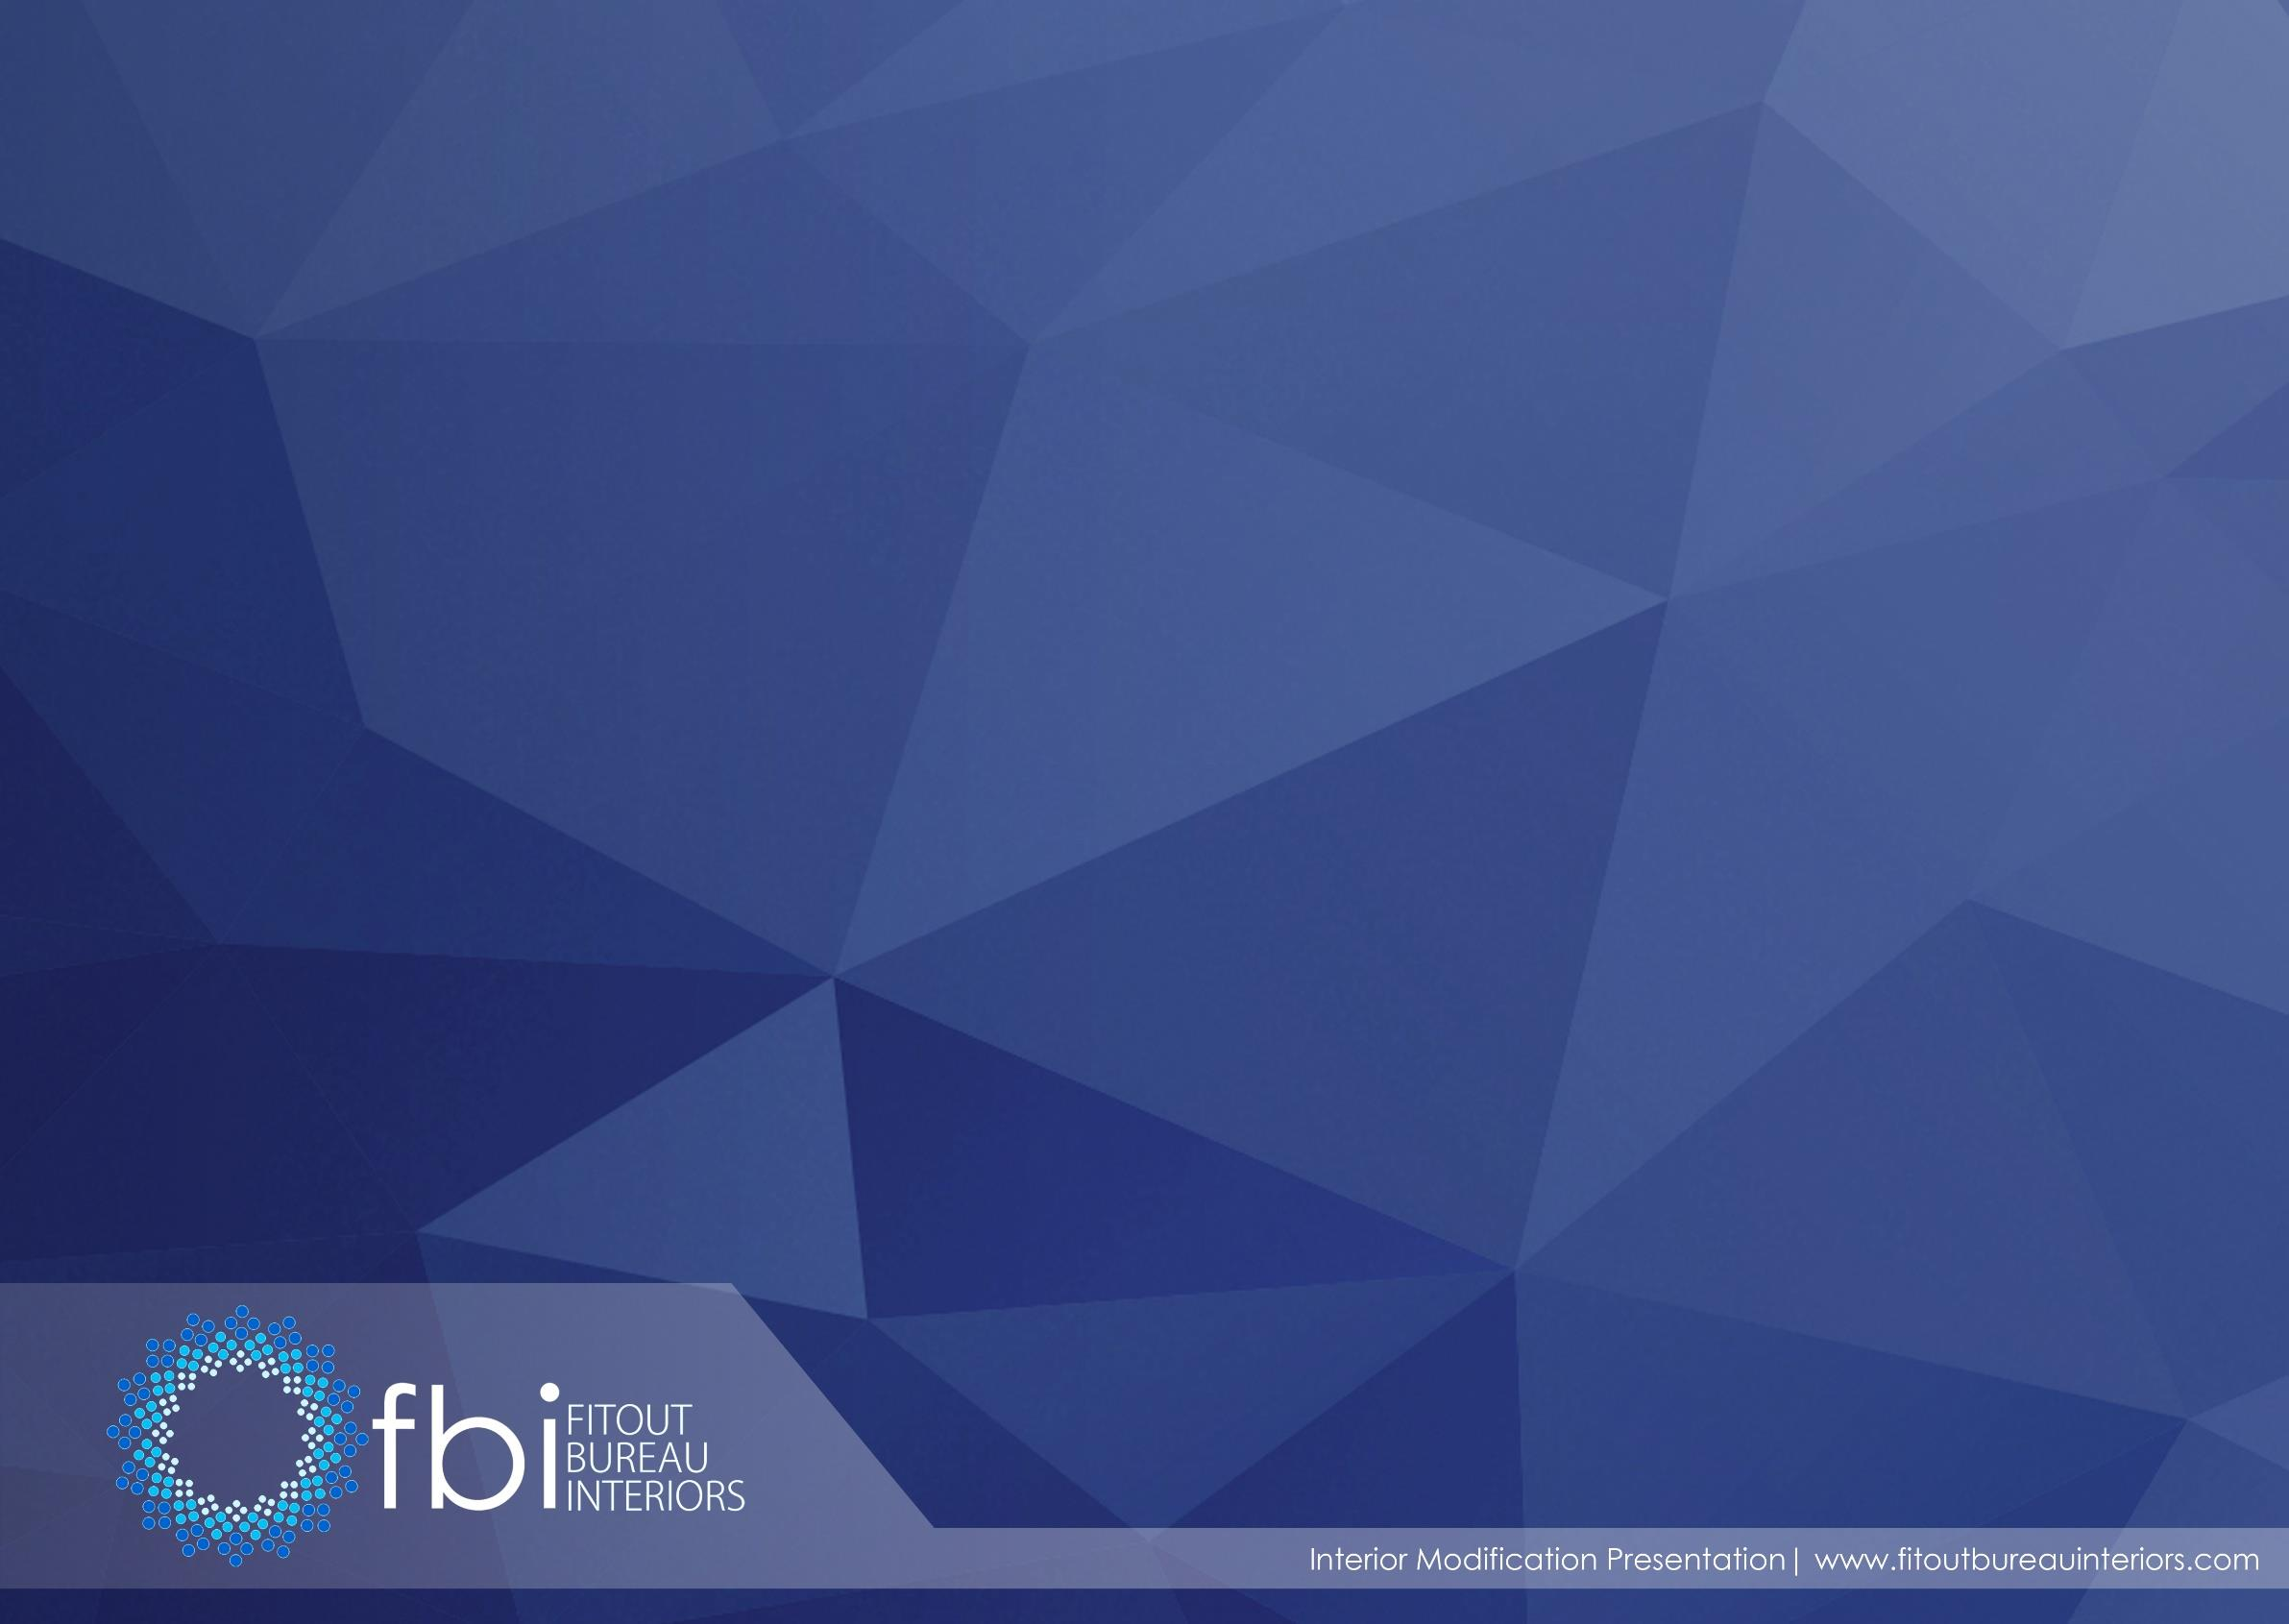
DESIGN FOR GRAND EXPRESS CAR WASH
INTERIOR FITOUT WORKS
Grand Express, Jebal Ali

Slide 2
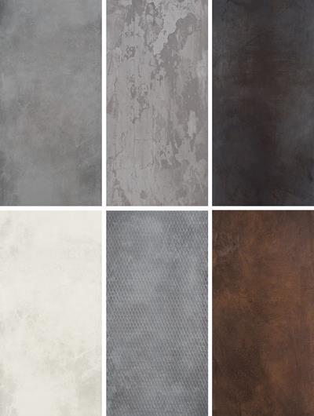
DESIGN CONCEPT:
MODERN
NEUTRAL
It's characterized by
simplicity, clean lines, and
neutral palette and
monochromatic design with
all shades of colours an
accent creating contrast. It
usually combines an open
floor plan, lots of light, and
functional modern flooring,
and it focuses on the shape,
color and texture of just a
handful of essential
elements.

Slide 3
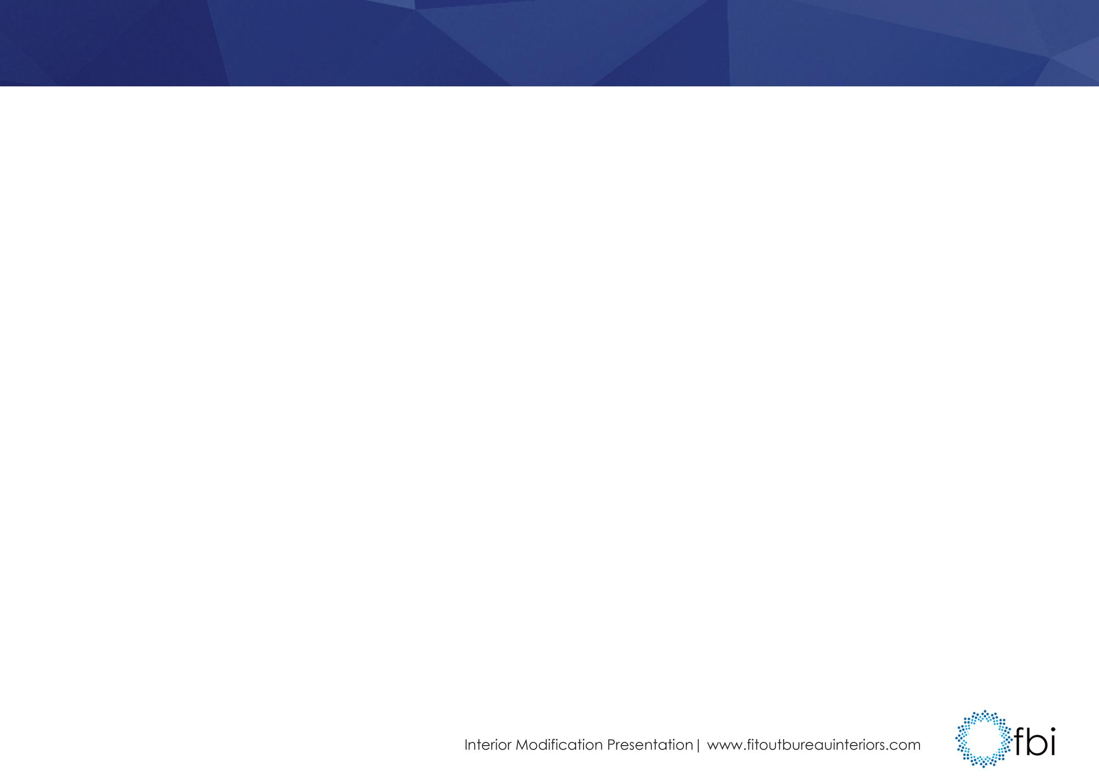
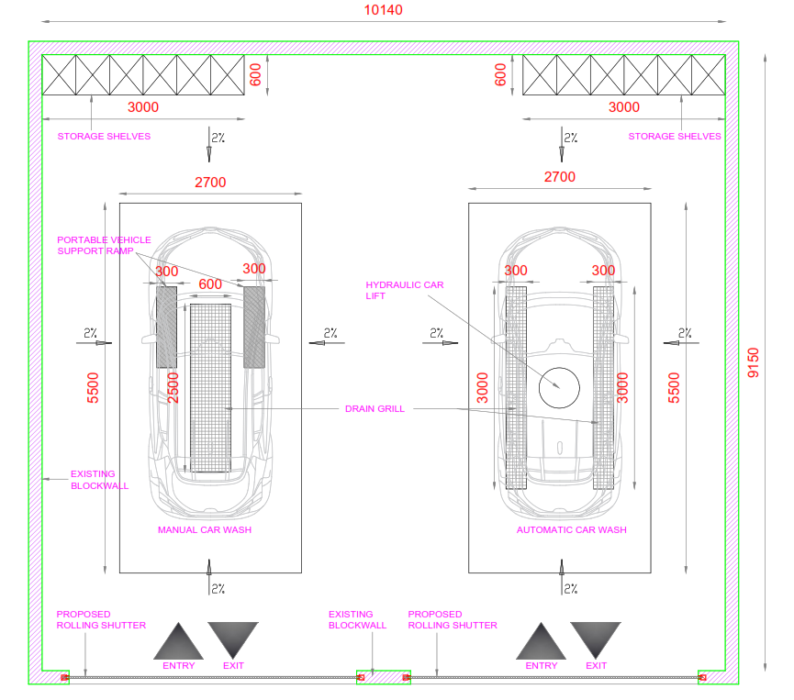

Slide 4
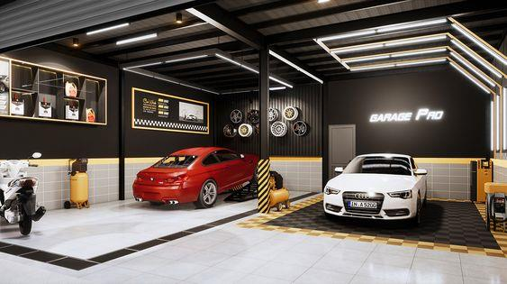


Slide 5
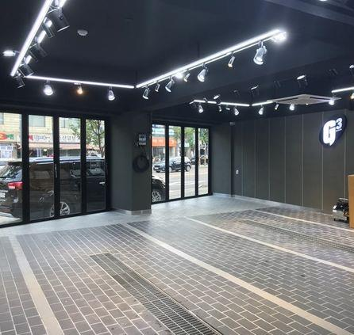
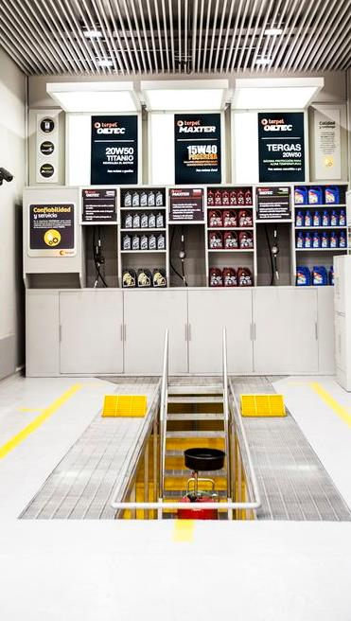

Slide 6
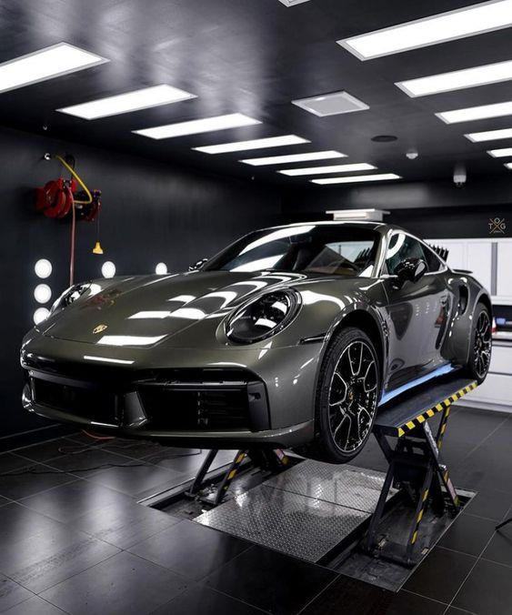
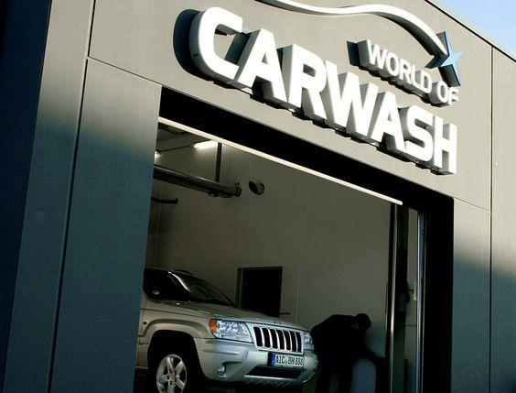

Slide 7
