Slide 1

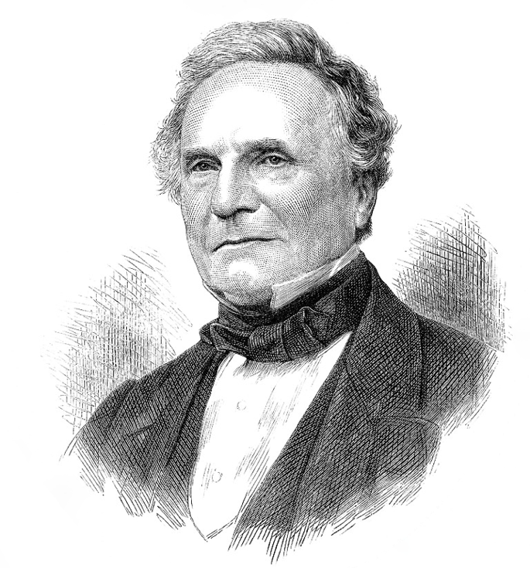
A
powerful attraction
exists, therefore, to the promotion of a
STUDY and DUTIES
of all others engrossing the time most completely, and which
is less benefitted than most
others by any acquaintance with
SCIENCE.
Charles Babbage (1791-1871)

